Slide 1

Effect Of Screen Time On Sleep Quality
Anish Phillip | Sarah Iranpour | Swati Akella
W241 Experiments and Causality
April 16th, 2020
Notes:
We conducted a sleep study to evaluate how screen time affects sleep quality

Slide 2
Agenda
Research Question and Experiment Design
Covariate Balance and compliance
Model Iteration
Post Experiment Feedback
Questions and Discussion

Slide 3
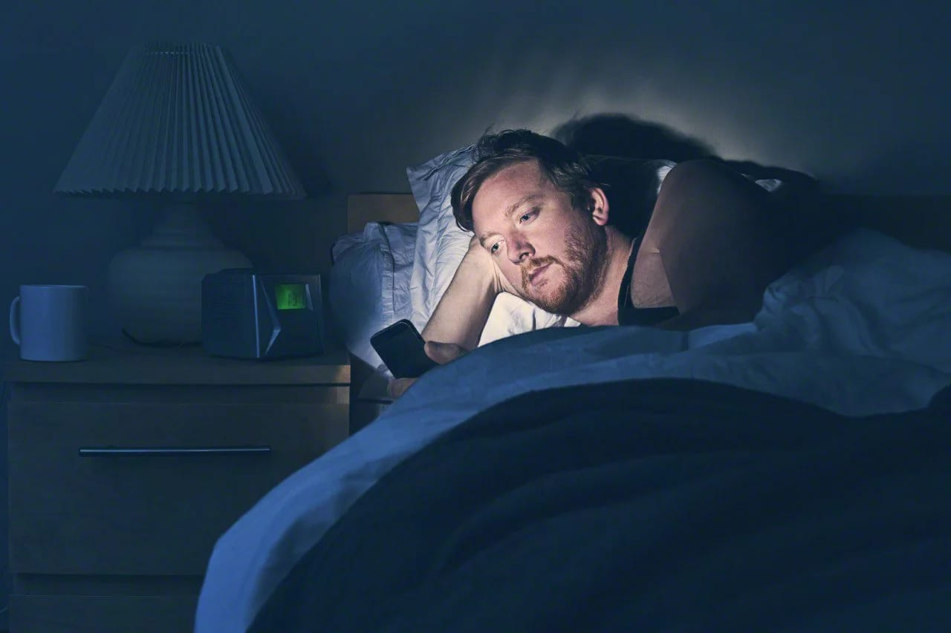
Research Question
Does 10-15 mins of not using electronic devices prior to sleep change sleep quality?
Notes:
What is your research question? Why is an experiment necessary?
What is the specific hypothesis you’re testing that is implied by theory or your question? What direction do you expect your outcomes to move as a consequence of treatment?
Our research question is xyz. It’s an important research question because it applies to everyone. Most people spend their entire day staring at screens and scrolling through our phones before going to sleep. People are saying use of electronic devices before bed messes up your sleep cycle. It delays your body’s internal clock and suppresses the sleep hormone melatonin. This makes it more difficult to fall asleep; you have worse sleep quality, and in the future it can lead to health problems

Slide 4
Hypothesis
H₀: Sleep Quality Screen Time = Sleep Quality Without Screen Time
H₁: Sleep Quality Screen Time ≠ Sleep Quality Without Screen Time
Notes:
What is your research question? Why is an experiment necessary?
What is the specific hypothesis you’re testing that is implied by theory or your question? What direction do you expect your outcomes to move as a consequence of treatment?
Our null hypothesis is screen time sleep quality is equivalent to no screen time sleep quality. Our alternate hypothesis is screen time sleep quality is not the same as no screen time sleep quality

Slide 5

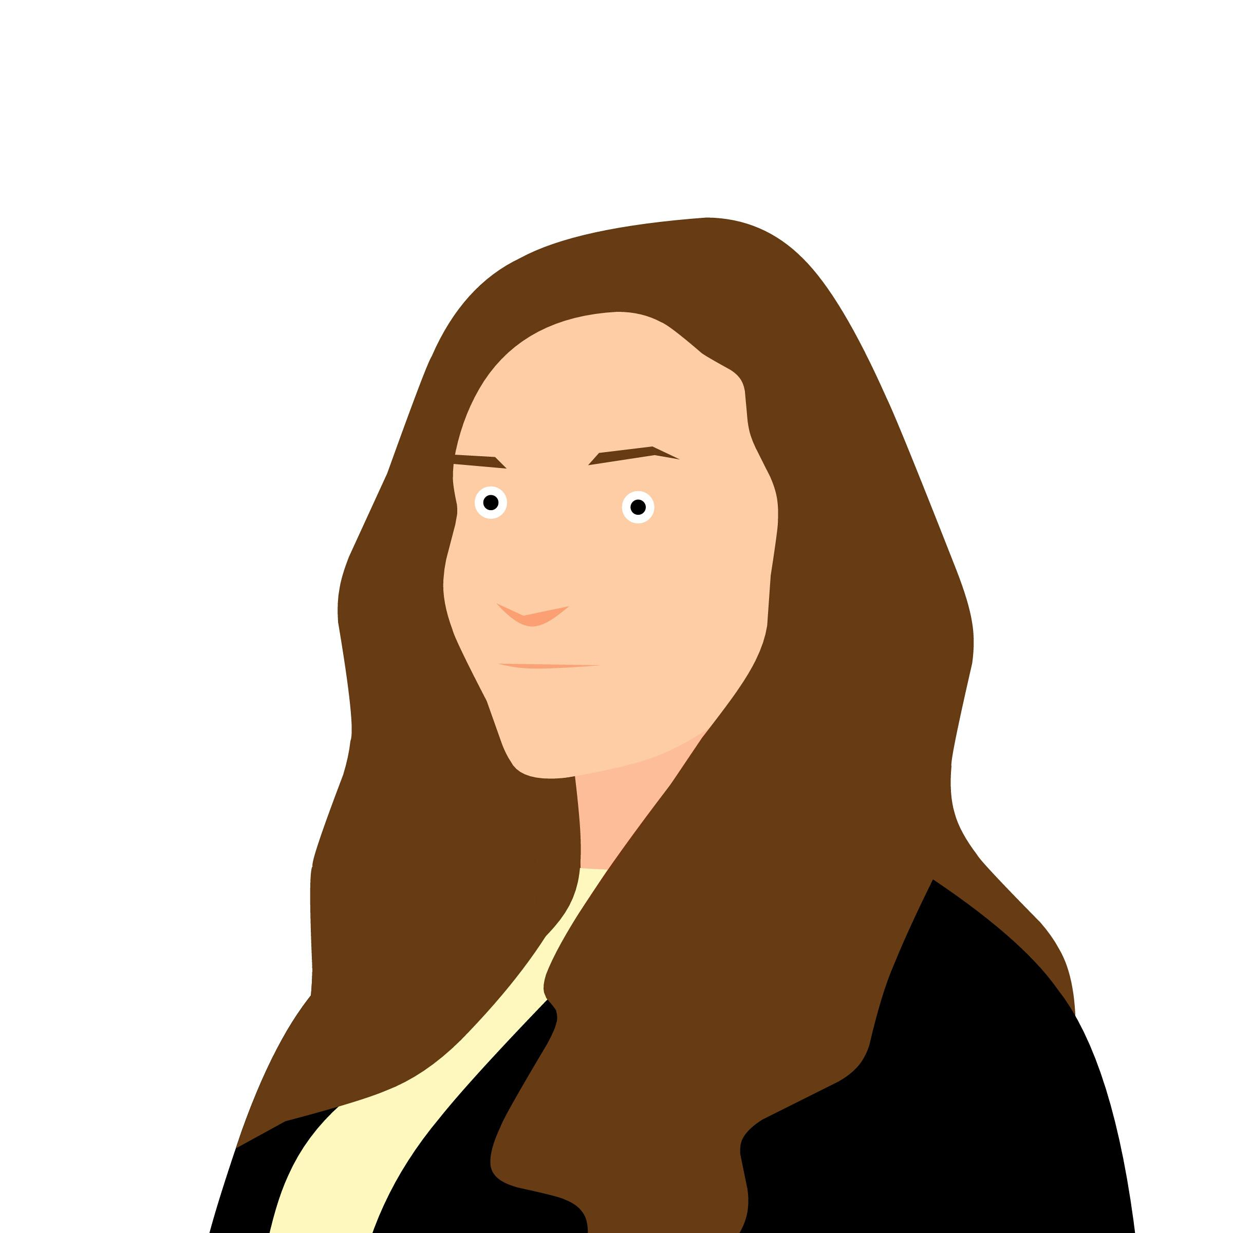
Crossover repeated measure design
R: Random Assignment X+: Treatment X-: Placebo O: Observation
Joe was randomly assigned to treatment in week 1
R O₀ X+₁ O₁ X+₂ O₂ X+₃ O₃ X+₄ O₄ X+₅ O₅ Week 1
R O₀ X-₁ O₆ X-₂ O₇ X-₃ O₈ X-₄ O₉ X-₅ O₁₀ Week 2
Jane was randomly assigned to placebo in week 1
R O₀ X-₁ O₁ X-₂ O₂ X-₃ O₃ X-₄ O₄ X-₅ O₅ Week 1
R O₀ X+₁ O₆ X+₂ O₇ X+₃ O₈ X+₄ O₉ X+₅ O₁₀ Week 2
Notes:
Draw out using ROXO grammar your experiment design, describe the comparisons that you’re going to make that tell you something causal. Call this RDD, or a DnD or a within subjects or a between subjects comparison
Crossover repeated measure design
Treated measure or control measure
At some point all participants were in treatment and control
across subjects comparison

Slide 6
Experiment Design
Week 1 | Sunday | Monday | Tuesday | Wednesday | Thursday | Friday
Morning |  | Survey | Survey | Survey | Survey | Survey
Night | Read | Read | Read | Read | Read
Week 2 | Sunday | Monday | Tuesday | Wednesday | Thursday | Friday
Morning |  | Survey | Survey | Survey | Survey | Survey
Night | Read | Read | Read | Read | Read
Pilot Study
Study duration: 10 days
Only assigned reading where the next day was a weekday
All participants were randomized equally to the placebo and treatment groups in week 1. They switched groups in week 2
Notes:
How did you randomize and did it work?
Pilot study
To minimize interference only took one person from each household
For our exp, we anticipated a lot of compliance issues, especially for the week where participants were asked not to use electronic devices before bed. We dealt with this by assigning readings either by ED or paper everyday before bed.
10 days split over 2 weeks. Explain the chart
Randomized
The duration of the study was 10 days. The 10 days were split equally over the span of two weeks (Sunday through Friday for each week). Participants were assigned a reading every night that was followed by a week day (Sunday through Thursday), and were asked to complete a survey the following morning (Monday through Friday). We decided not to include weekends because people’s weekend sleep behavior may not be consistent with their weekday sleep behavior.

Slide 7

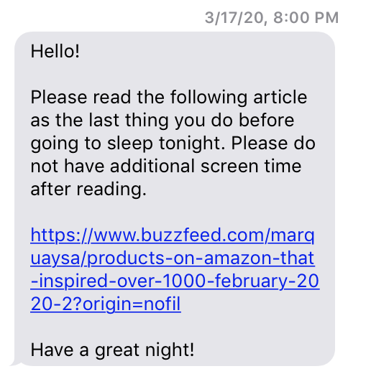
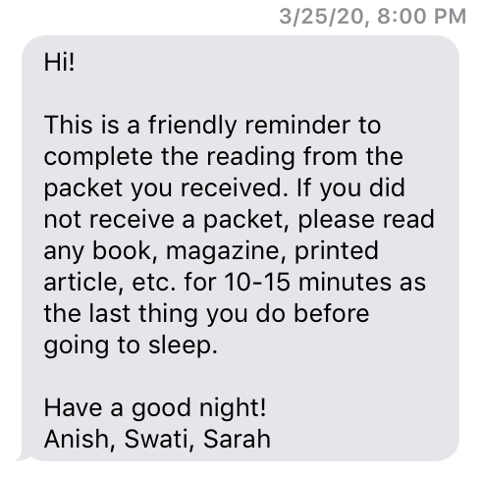
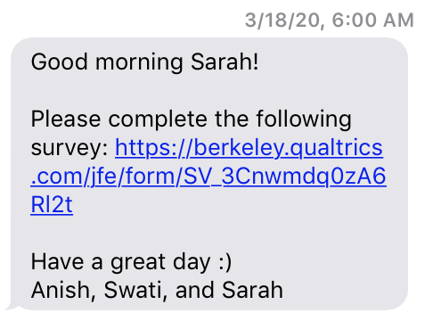
Experiment Design
Placebo Group: Will complete the assigned reading on a device for 15 minutes prior to sleep
Treatment Group: Will complete the assigned reading on paper for 15 minutes prior to sleep
Notes:
What is your treatment? Be specific. Show pictures of it, show the language that you used, etc.
Treatment and control group
Also anticipated people would forget to do readings
We defined our control group as people using ED 10-15 mins before bed and treatment as not using ED 10-15 before bed. We knew compliance would be an issue, especially in the treatment group since it’s hard for people to remember to put their phone down. It’s easy to get caught up in a youtube video or scrolling through your instagram feed.
We needed a way to remind people every night so we decided to assign readings. The control group would read an article on their ED for 10-15 mins and then go to sleep. Those in the treatment group would read articles that we mailed them for 10-15 mins and then sleep. We sent reminders to everyone at 8pm. We have screenshot examples on the left and the middle. you ‘ll see for the control group we included the link to the article so they wouldn’t have to go looking for it. In the morning, they would receive the link to the survey within the hour they typically wake up to fill in.

Slide 8
Agenda
Research Question and Experiment Design
Covariate Balance and compliance
Model Iterations
Post Experiment Feedback
Future scope, Questions and Discussion

Slide 9
Baseline Data
General participant information
Age, gender, employment status, education
Living Conditions
Cohabitants, house type, neighborhood, and neighborhood noise level
Screen Time
Screen time in the evening and 15 minutes prior to sleep
Sleep Metrics
Bed time, wake up time, sleep quality, sleep matrix
Morning Retention Score
Current reading habits and morning retention
Blocks
Screen Time Usage
Children Under 5 Years Of Age
Notes:
We collected baseline data prior to start of study
We included variables that we thought would affect sleep quality
This included general participant information like age, gender
We were also interested in the living conditions like number of cohabitants, house type, neighborhood type.
The current screen time was
Talk about the POS scale and Matrix Sleep Quality scores - time it takes interrupted sleep time, waking up earlier than intended wake up time

Slide 10
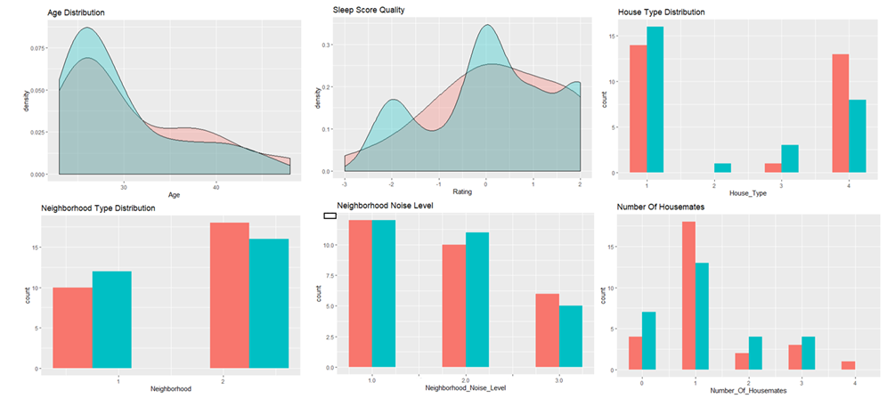

Covariate balance
Notes:
Describe your analysis, results
After Blocking, we balanced our covariates to ensure we have a similar population in both groups. Again, each participant went through both control and treatment.

Slide 11
Compliance
Impact of COVID-19 on Treatment application
Participants who did not receive mail due to COVID-19 and were asked to do self-reading
Lower compliance was observed among the participants who were asked to do self reading
Who is a complier?
Participant who read the assigned article (Treatment - Printed; Placebo - Electronic)
Did the reading as last activity before going to bed
No screen time 15 minutes before sleep
Notes:
We faced partial non compliance where many participants did not follow the instructions for a couple of days in the week.
Also, our mail was not delivered to some participants due to the lockdown. We asked them to do self reading in lieu of our paper. We found out that there was lower compliance in this group of participants in treatment group.
We debated on who should we classify as a complier and ended up with a participant who read the assigned article (phone in placebo and paper in treatment). This participant should also have done this reading as the last activity before going to bed. The participant should also have 15 minutes of screentime in placebo and no screen-time in treatment.

Slide 12
Treatment Flow
Randomized = 57
57x10 = 570
Week 1
Placebo = 29x10 = 290
Treatment = 28x10 = 280
Week 2
Placebo = 28x10 = 280
Treatment = 29x10 = 290
468
Placebo = 134
Treatment = 101
Placebo = 123
Treatment = 111
302
Compliant = 90
Partial/Not Compliant = 44
Compliant = 57
Partial/Not Compliant = 44
Compliant = 91
Partial/Not Compliant = 32
Compliant = 64
Partial/Not Compliant = 47
Notes:
Explain who/what your measurement units are. People? From where? Robots? What type?
Present a flow document like in Box 13.3
We Started with expectation of 570 records, ended up with 468
Due to COVID-19 we had lower compliance in treatment group
3 participants attrited week one of the experiment.
In our models we’ll take you through how we dealt with compliance issues

Slide 13
Agenda
Research Question and Experiment Design
Covariate Balance and compliance
Model Iterations
Post Experiment Feedback
Questions and Discussion

Slide 14
Model iterations
Model categories:
Observation level
Candidate level (Average, Min, Max, Last and First obs)
Imputed data model (Avg of Control and Min of control)

Slide 15
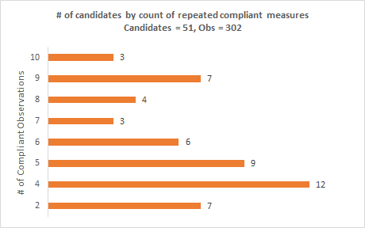
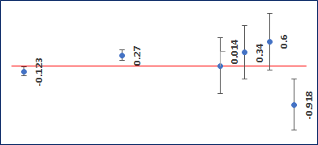

Model Iteration 1: Individual Observation
Individual Observations - All (N=468)
Individual Observations - Compliant (N=302)
Age: 18-25
Individual Observations - Compliant (N=302)
Age: 26-35
On average candidates who complied to the treatment and placebo conditions reported a 0.270 (0.106) positive delta in their sleep quality on application of treatment vs placebo
Age: 36-45
Age: >45
p < 0.05
Notes:
Individual observation level data
No significant difference between treatment and placebo
Positive treatment effect when limited to compliant observations
Treatment effect among compliers tend to vary by age groups
Candidate level model
No significant difference among treatment and placebo group
Among compliers some positive treatment effect - Not significant in most cases

Slide 16
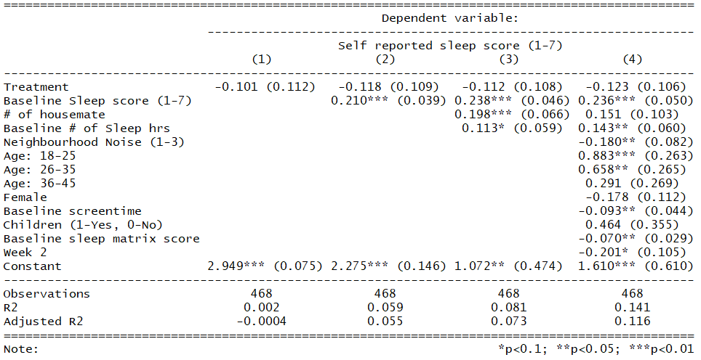
Model 1 (a): Individual Observation
Notes:
All recorded measurements
Treatment effect is not significant
Overall diff of avg outcome between treatment and placebo was negative

Slide 17
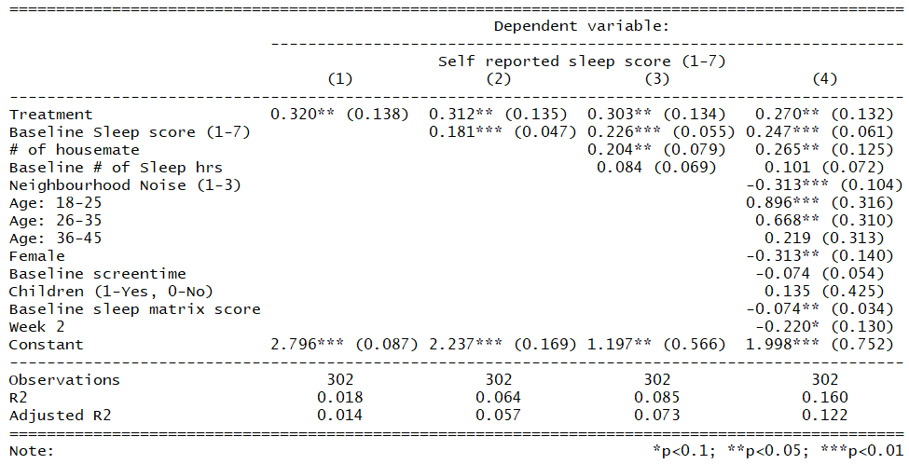
Model 1 (b): Individual Compliant Observation
Notes:
Filter for compliant records, we get 302 records. Get significant treatment
0.3 on a scale of 1-7
Bias due to having more data from certain participants(some people have more readings). Most compliant observations
This is everyone who was a complier. So they did the reading and they used phone or did not use phone 15 mins before. This is taking into account each time they filled out a survey. So if i filled out the survey 6 times, then i will have 6 records.
Positive treatment effect
Treatment effect is biased towards people who we have more data points

Slide 18
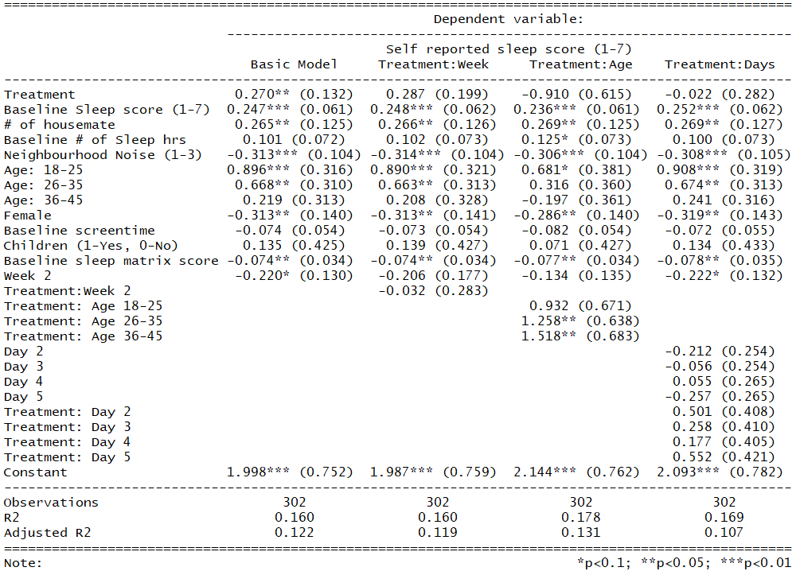
Model 1 (c): Heterogeneous Treatment Effects
Notes:
Basic model is same as the previous slide
Heterog by looking at diff covariates. Week 1 vs week 2 and found no difference in effect in treatment across the 2 weeks
Age - slight difference in treatment effect on the older treatment population. Effect higher in 36-45 age group. Greater than 45 has a negative treatment effect but not significant
Days - no heterogeneity on days.
No longitudinal tracking for everyone bc compliance. Very few continuous for 5 days

Slide 19
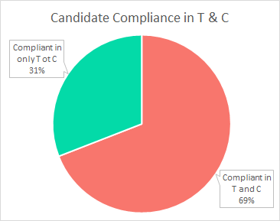
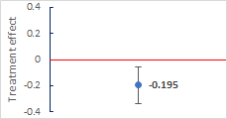
Model Iteration 2: Candidate level
Candidate Avg - All (N=110)
p < 0.05
Notes:
Individual observation level data
No significant difference between treatment and placebo
Positive treatment effect when limited to compliant observations
Treatment effect among compliers tend to vary by age groups
Candidate level model
No significant difference among treatment and placebo group
Among compliers some positive treatment effect - Not significant in most cases

Slide 20
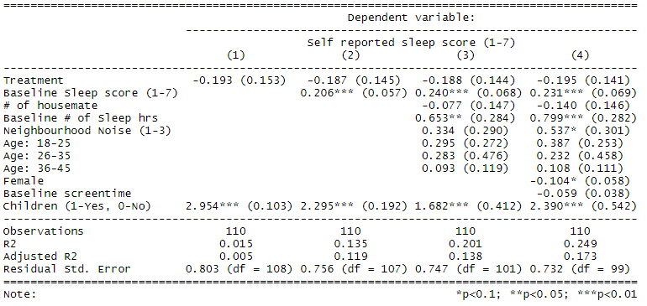
Model 2 (a): ATE Of Average Recorded Value
Notes:
No sig diff across treatment effect on diff days so moved into this model
But didn’t find any significant different in treatment vs placebo

Slide 21
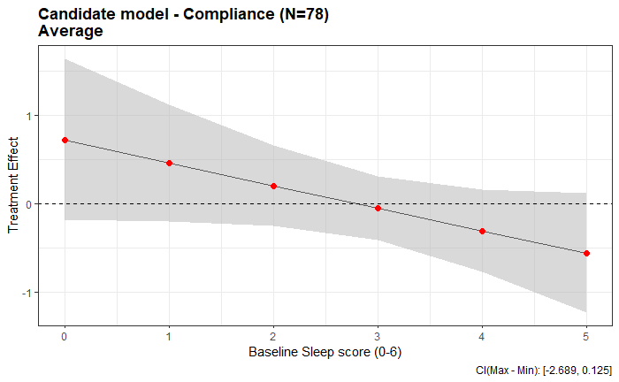
Model Iteration 2 (b): Candidate level
p < 0.05
Notes:
Individual observation level data
No significant difference between treatment and placebo
Positive treatment effect when limited to compliant observations
Treatment effect among compliers tend to vary by age groups
Candidate level model
No significant difference among treatment and placebo group
Among compliers some positive treatment effect - Not significant in most cases

Slide 22
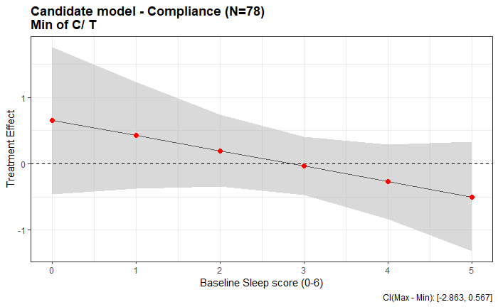
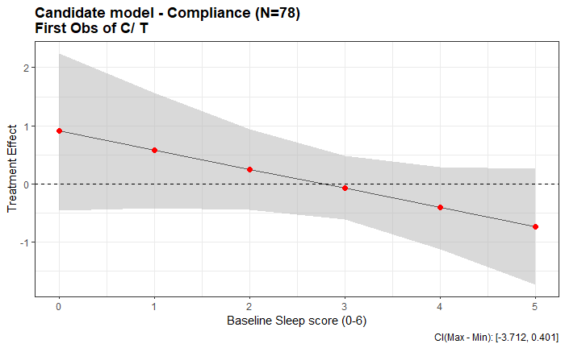
Model Iteration 2 (c): Candidate level
Other Iterations:
Max of all C/ T observations
Last C/ T observation
Max of C; Min of T
Min of C; Max of T
The general trend of treatment effect vs pre-experiment quality of sleep indicates - treatment effect might be higher for candidates who slept poor before the start of experiment
p < 0.05
Notes:
Individual observation level data
No significant difference between treatment and placebo
Positive treatment effect when limited to compliant observations
Treatment effect among compliers tend to vary by age groups
Candidate level model
No significant difference among treatment and placebo group
Among compliers some positive treatment effect - Not significant in most cases

Slide 23
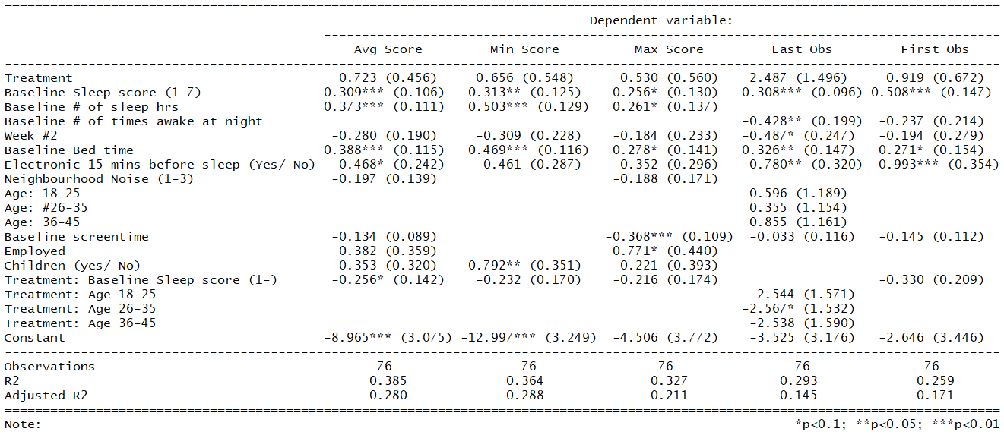
Model 2 (b): Average Recorded Value - Compliant
Notes:
Also didn’t find significance here either

Slide 24
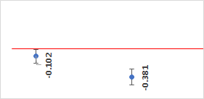
Model Iteration 3: Imputed Observations
Imputing missing values with average of C
Imputing missing values with min of C
p < 0.05
Notes:
Individual observation level data
No significant difference between treatment and placebo
Positive treatment effect when limited to compliant observations
Treatment effect among compliers tend to vary by age groups
Candidate level model
No significant difference among treatment and placebo group
Among compliers some positive treatment effect - Not significant in most cases

Slide 25
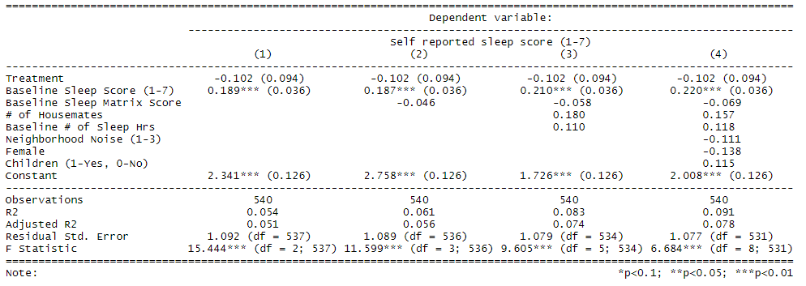
Model 3 (a): Imputing for missing values - Avg of Placebo obs
Notes:
May not have filled in survey because maybe had bad night and were really tired in the morning. We took his suggestion to fill in missing data with avg of control
Did not find any significance
Mean is worst case that helps in failing to reject the null hypothesis

Slide 26
Agenda
Research Question and Experiment Design
Covariate Balance and compliance
Model Iterations
Post Experiment Feedback
Questions and Discussion

Slide 27
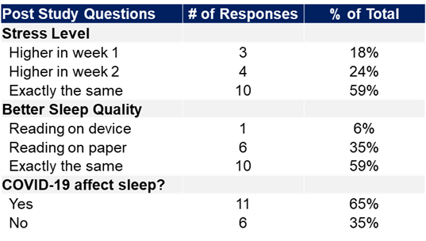
Experiment Feedback
Sometimes I stay up late to study for my midterm and that definitely affected my sleep
I am glad that I was part of this survey and really enjoyed the reading material provided, would like to develop it as a habit to read something before going to bed.
Notes:
Not many responses
People seemed to be affected by COVID-19

Slide 28
Agenda
Research Question and Experiment Design
Covariate Balance and compliance
Model Iterations
Post Experiment Feedback
Questions and Discussion

Slide 29
Questions
How would you define a complier?
How would you assess partial compliance?
Does randomization hold with partial and non compliance?
Are there other models we should consider?

Slide 30

Appendix
Notes:
List the questions and concerns that you want your peers to help you puzzle through

Slide 31
References
The Sleep Revolution, Arianna Huffington Pg. 287-289
Compliance effects in a randomised controlled trial of yoga for chronic low back pain: a methodological study, Physiotherapy. 2014 Sep; 100(3): 256–262, H.E. Tilbrook,⁎ C.E. Hewitt, J.D. Aplin,1 A. Semlyen, A. Trewhela, I. Watt, and D.J. Torgerson
A case study in comparing therapies involving informative drop-out, non-ignorable non-compliance and repeated measurements, STATISTICS IN MEDICINE Statist. Med. 2005; 24:3773–3787, T. Harkanen, P. Knekt, E. Virtala, O. Lindfors

Slide 32
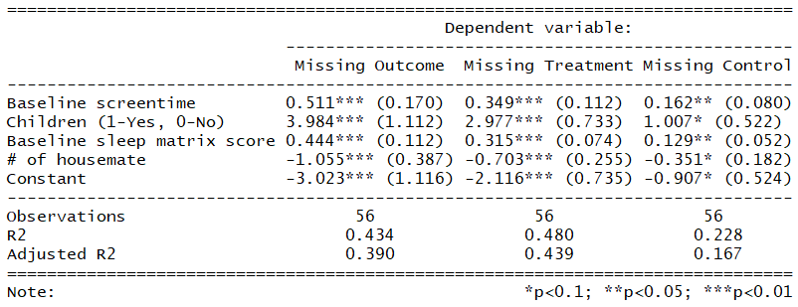
Sensitivity Analysis - Missing data pattern

Slide 33
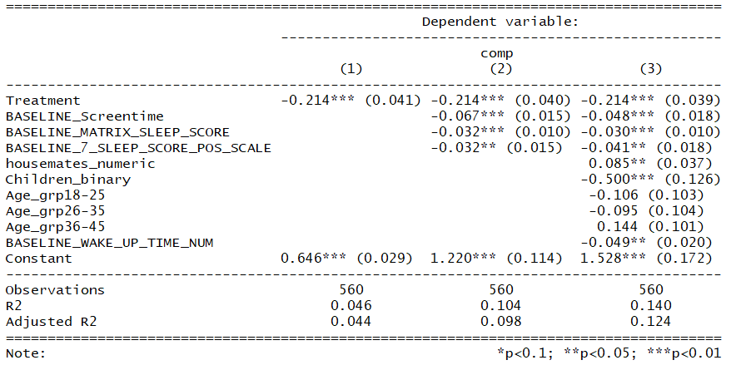
Sensitivity Analysis - Missing data by treatment

Slide 34
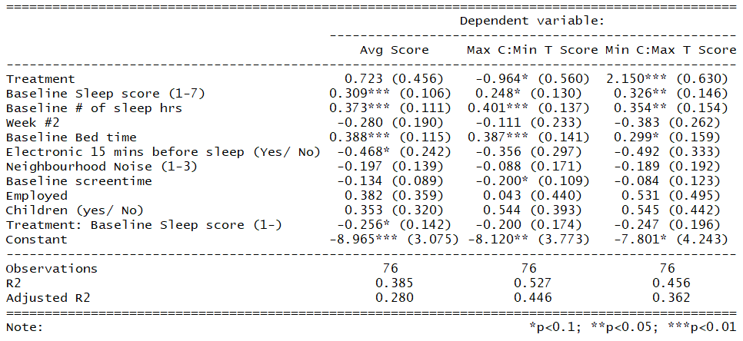
Model 2 (c): Average Recorded Value - Compliant
Notes:
Also didn’t find significance here either

Slide 35
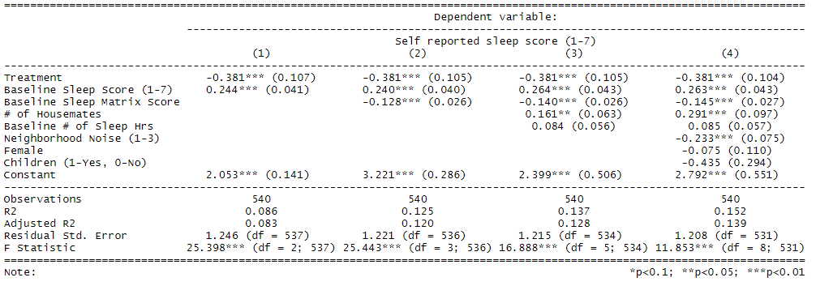
Model 3 (b): Imputing for missing values - Min of Control Obs
Notes:
Alex also suggested filling in with the worst case scenario where we found negative treatment and significance

